Slide 1
Word tokenizer Demo
With
NLTK Package.

Slide 2
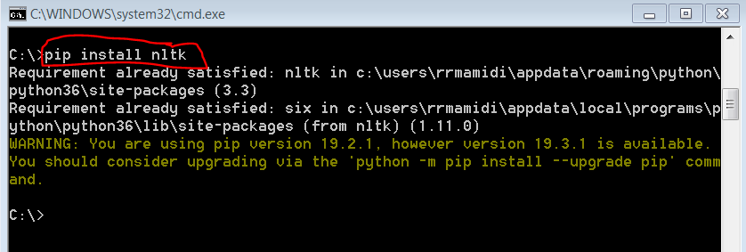
Make sure you have installed python and add python path to system environment variables.
Open command prompt and Install NLTK package
- pip install nltk ( in my case it was already installed.)

Slide 3
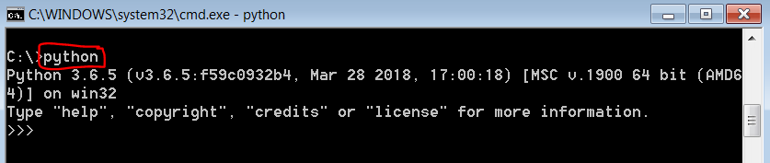
After installing NLTK, type python in command prompt to get python IDE.

Slide 4
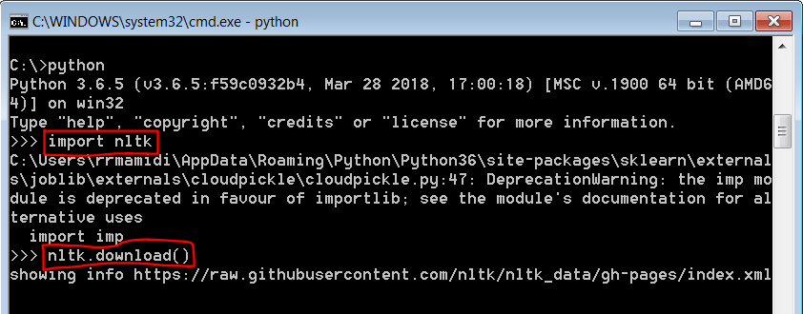
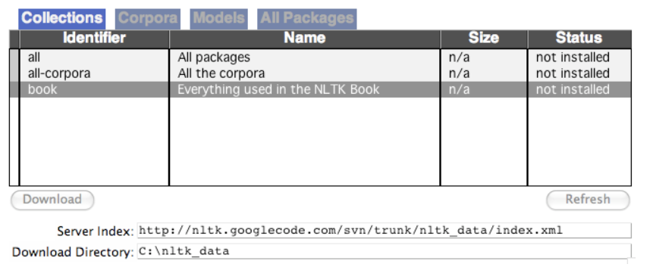
Import nltk and download all packages related to nltk.

Slide 5
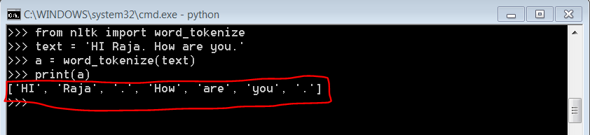
Import word_tokenize to tokenize words from given text data.

Slide 6
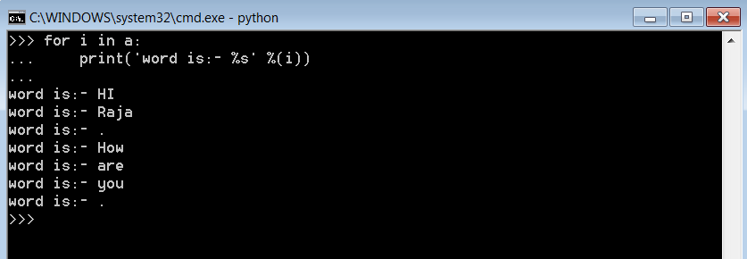
Below are the words in give text data.

